Slide 1
AP157 Capstone Project
Jed Jerrel K. Escaran
BS3 Applied Physics
May 21, 2024

Slide 2
Racial profiling is the practice of targeting individuals for suspicion of crime based on their race, ethnicity, religion, or national origin. ª
Reasons Why Racial Profiling is Bad: ª
Violation of Human Rights
Ineffectiveness in Law Enforcement
Erosion of Trust
Psychological and Social Harm
Legal and Ethical Concerns
Instances of Wrongful Incrimination:
Traffic Stops and Searches
Stop-and-Frisk Practices ^{b}
Post-9/11 Policies ^{c}
Cases of Wrongful Arrest ^{d}
ª https://www.aclu.org/issues/racial-justice/race-and-criminal-justice/racial-profiling
^{b} https://www.nyclu.org/data/stop-and-frisk-data
^{c} https://www.hrw.org/reports/2002/usahate/usa1102-04.htm
^{d} https://www.npr.org/sections/thetwo-way/2018/05/03/607973546

Slide 3
This study aims to spread awareness and educate that no matter the situation, one must never judge another based on their color.
“never judge a book by its cover”
-Aristotle (probably)

Slide 4

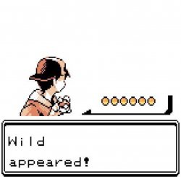

???

Slide 5



???
???/???
Scyther
Bug/Flying
Togekiss
Fairy/Flying
Mamoswine
Ice/Ground

Slide 6



Jed Jerrel K. Escaran
BS3 Applied Physics
AP157 Capstone Project
May 21, 2024
©The Pokémon Company

Slide 7
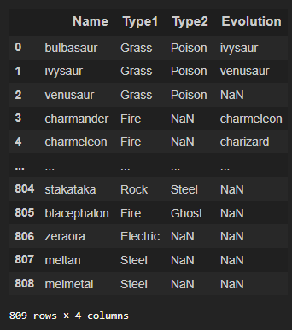
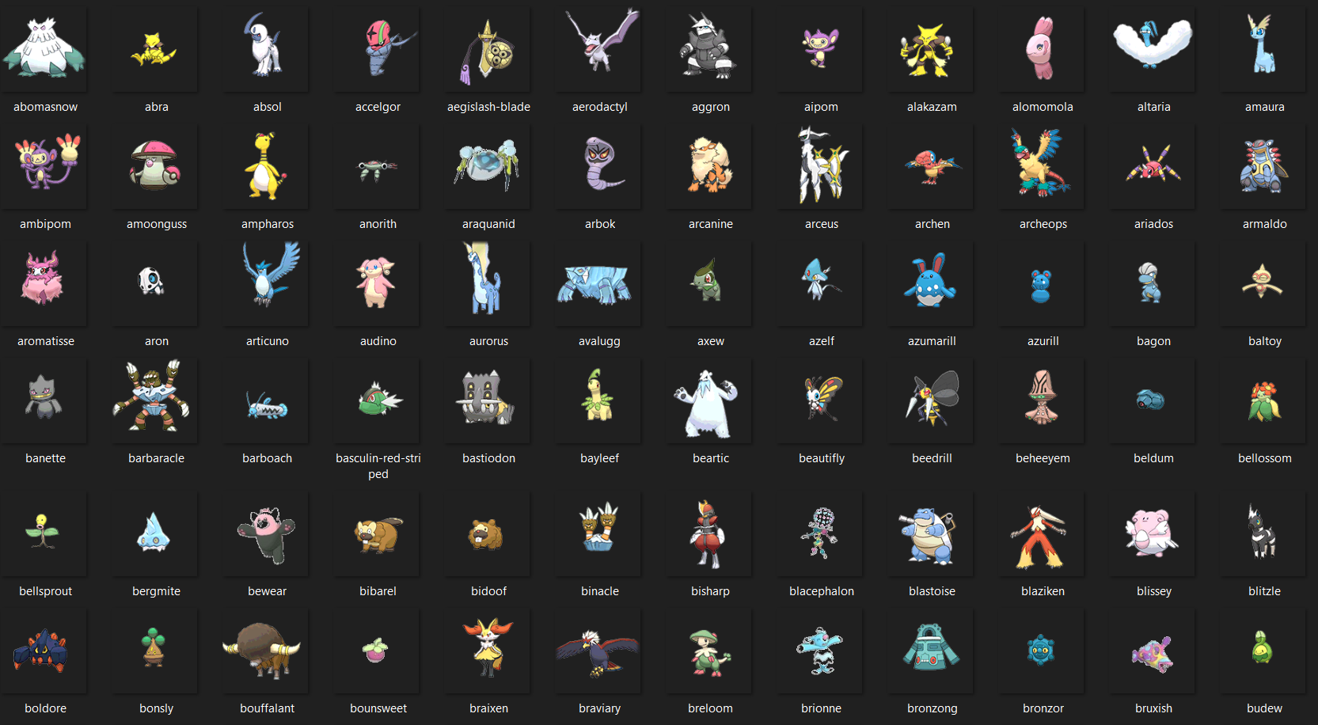
Dataset
Datasets were retrieved from Kaggle.com
Dataset by Vishal Subbiah was used in this study ¹
Figure 1. Pokémon Dataset
Figure 2. Pokémon Images
¹ https://www.kaggle.com/datasets/vishalsubbiah/pokemon-images-and-types

Slide 8
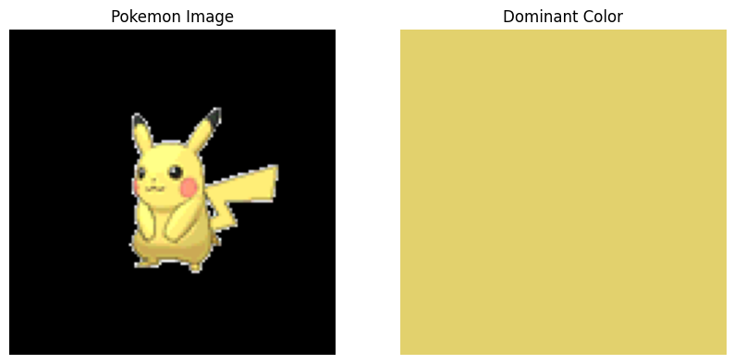

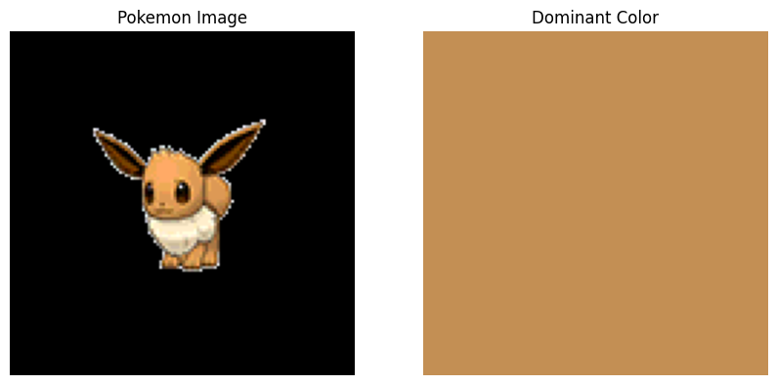

Image processing
Color Thief ²
a Python library that extracts the dominant color or a palette of colors from an image
utilizes the k-means clustering algorithm to analyze colors and identify the most prominent colors
Figure 3. Color Thief process flowchart
Figure 4. Pikachu dominant color and palette
Figure 5. Eevee dominant color and palette
² https://github.com/fengsp/color-thief-py

Slide 9
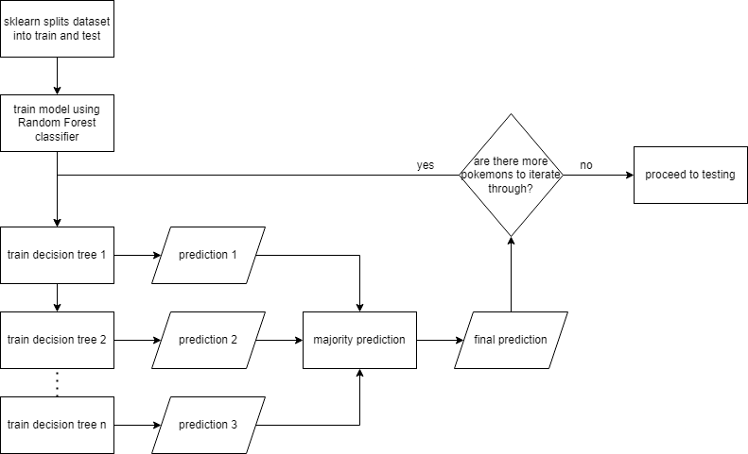
Machine learning
Scikit-learn ³
Model selection: train_test_split was used to split dataset (names, types, colors) into train and test subsets
Model training: random forest classifier was used to train the model
Figure 6. Model training flowchart using Random Forest classifier
³ https://scikit-learn.org/stable/

Slide 10
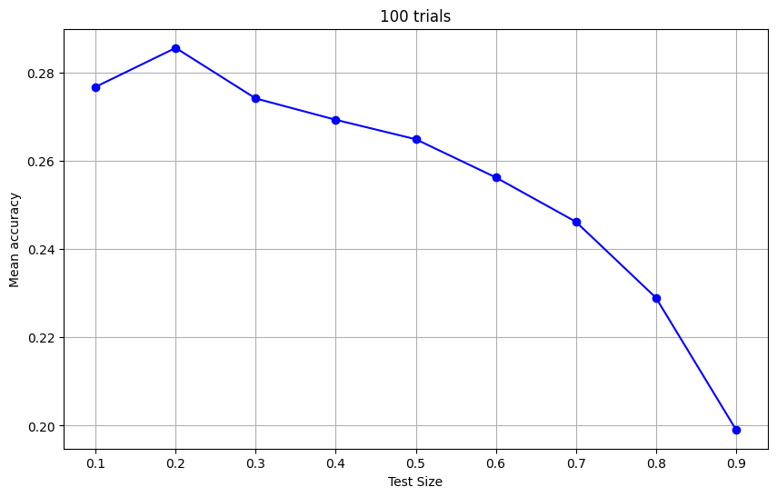
Machine learning
Figure 7. Mean accuracy of varying test sizes over 100 trials
³ https://scikit-learn.org/stable/

Slide 11
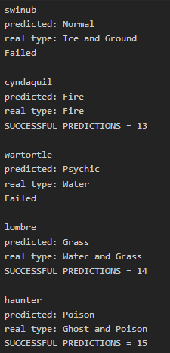
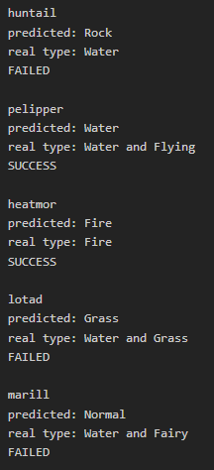


Results
First test: at least one predicted type matches
Second Test: predicted type must match primary type
Figure 8. First test sample results and accuracy
Figure 9. First test sample results and accuracy

Slide 12
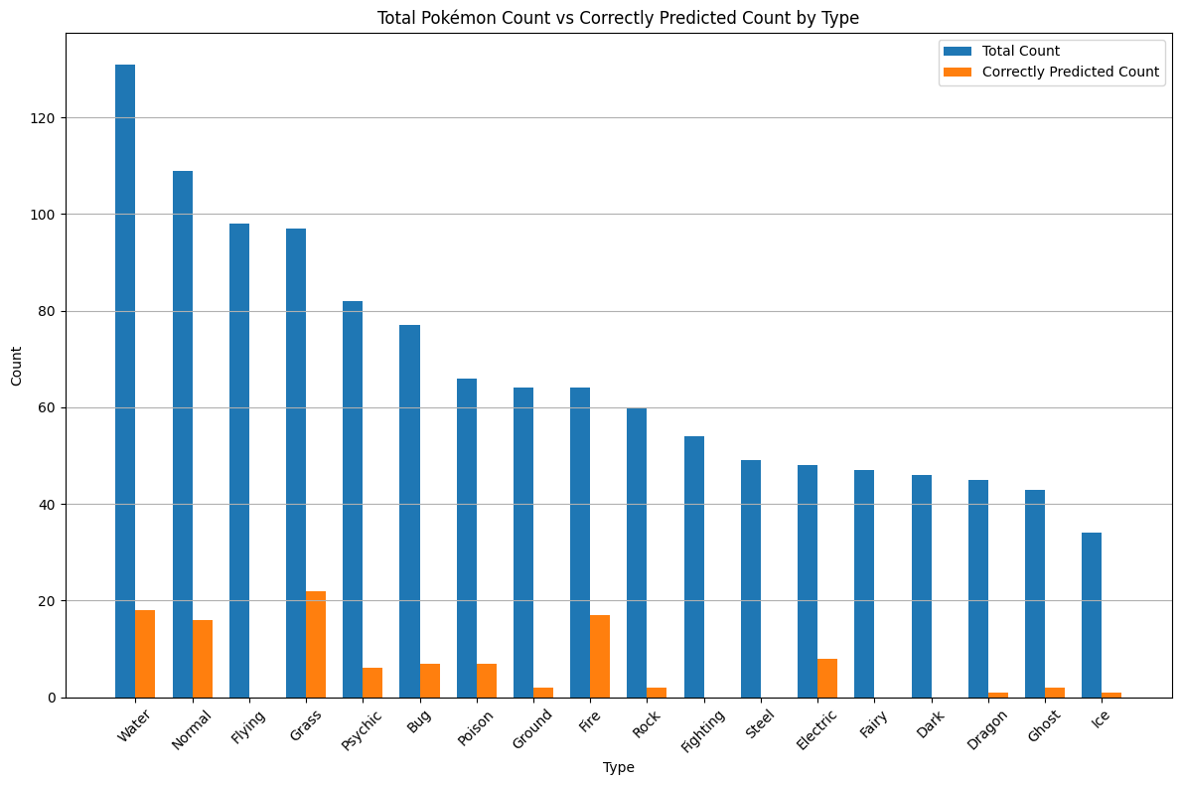
Results
Figure 10. Total Pokémon count with the number of correctly predicted count for each type

Slide 13
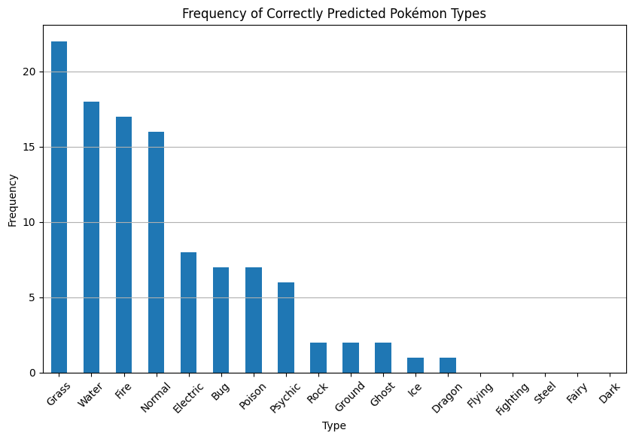
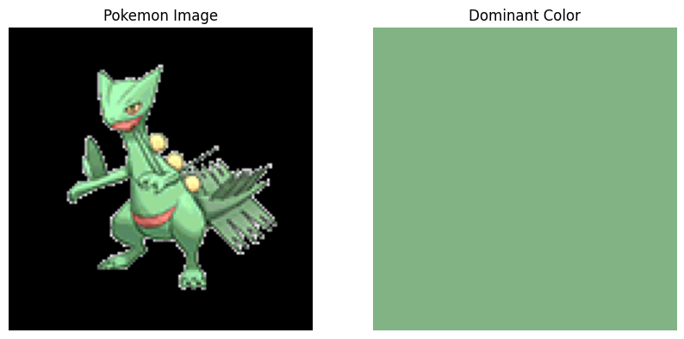
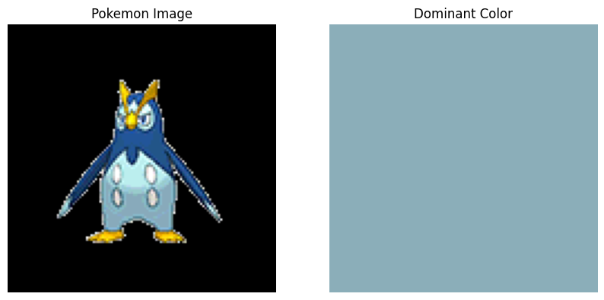
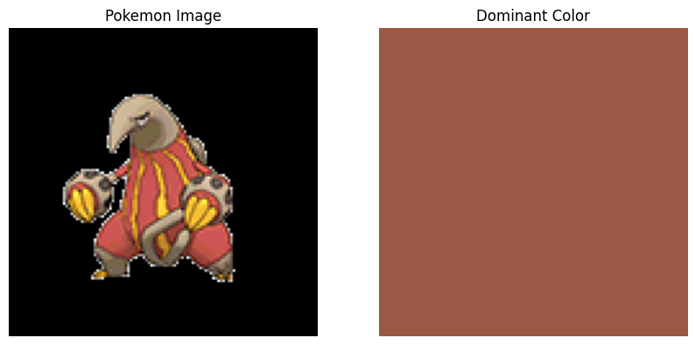
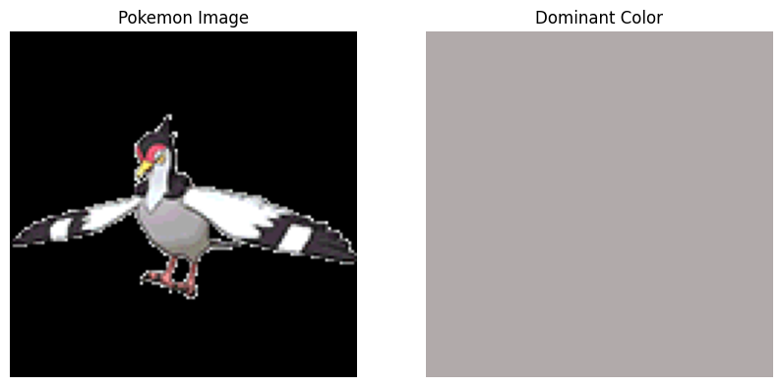
Results
Figure 12. Grass, Water, Fire, and Normal type sample Pokémons and their dominant color
Figure 11. Frequency of successful predictions by type

Slide 14
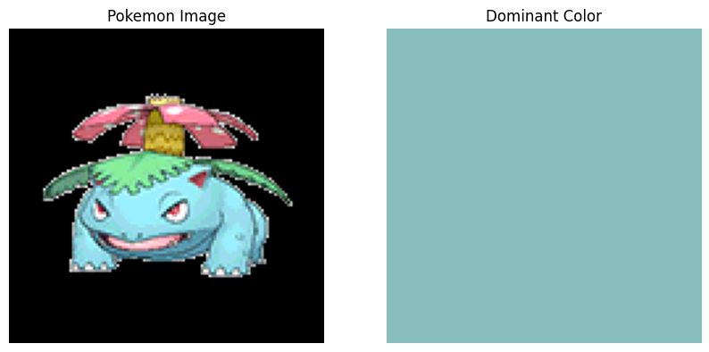


Insights and Limitations
Pokémon aesthetics
Figure 13. Venusaur, a Grass/Poison type Pokémon, with its dominant color, palette and model-predicted type

Slide 15
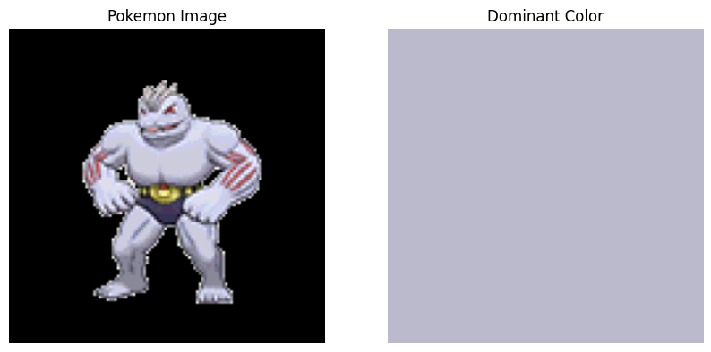
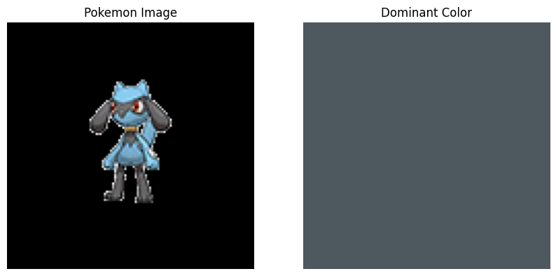
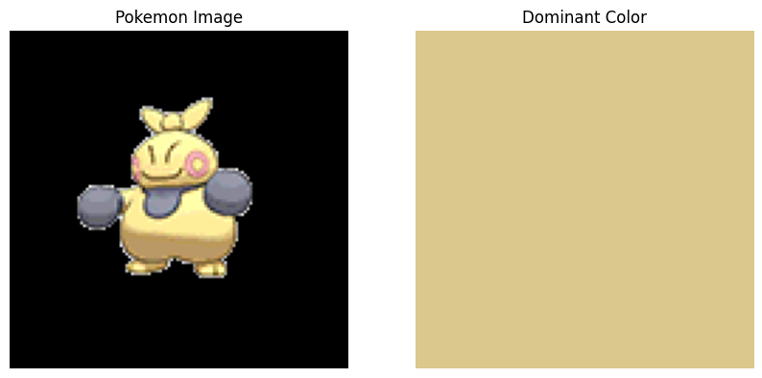
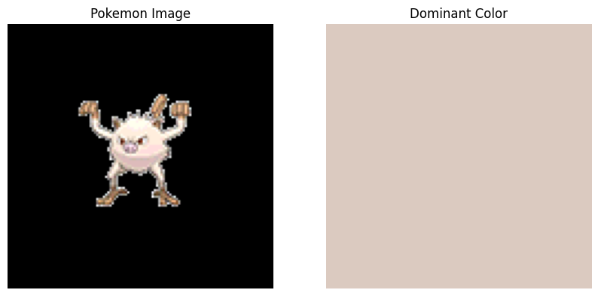
Insights and Limitations
Lack of representative color
A.
B.
C.
D.
Figure 14. Four pure fighting-type pokemons with varying dominant colors. A = Machoke. B = Riolu. C = Makuhita. D = Mankey

Slide 16
???
???/???
Scyther
Bug/Flying
Togekiss
Fairy/Flying
Mamoswine
Ice/Ground

Slide 17
???
DARK???/???
Scyther
Bug/Flying
Togekiss
Fairy/Flying
Mamoswine
Ice/Ground

Slide 18
???
DARK???/???
Scyther
Bug/Flying
Togekiss
Fairy/Flying
Mamoswine
Ice/Ground

Slide 19
Eelektross
ELECTRIC
Scyther
Bug/Flying
Togekiss
Fairy/Flying
Mamoswine
Ice/Ground
X
X
✓

Slide 20
Conclusion
Color of Pokémon is not a good indicator for type, with an accuracy of only 26.9% and 25.2% on the first and second test, respectively.
Usage of CNN deep learning algorithm might be able to achieve higher accuracy.
Using CNN, double type prediction may be possible.

Slide 21

Conclusion

Slide 22
References
Dataset:
Subbiah, V. (March 2024). Pokemon Image Dataset. Retrieved from https://www.kaggle.com/datasets/vishalsubbiah/pokemon-images-and-types on May 16, 2024
Other images and GIFs:
Pokémon Database (n.d.). Retrieved from https://pokemondb.net/ on May 16, 2024

